Slide 1

End-to-End E-commerce Data Pipeline
Team Members
2200031044 - I SAI MANI
2200031512 – M V SAI TEJA
2200032666 – B SAI VIVEK --- Team Lead
Under Guidance of -- Subbarao Maram
KL University

Slide 2
Project Overview
What I Built:
An integrated system to manage and visualize order data using Microsoft Azure and Power BI.
Key Features:
- Cloud-hosted transactional data
- Automated ETL using Azure Data Factory
- Visual analytics in Power BI

Slide 3
Tools & Services Used
- Azure SQL Database – Storing transactional order data
- Azure Data Factory – Automating data movement from SQL to Blob Storage
- Azure Blob Storage – Saving data as CSV files
- Power BI – Building an interactive dashboard

Slide 4



Data Modeling
Tables Created:
- Customers
- Products
- Orders
- Order Details
- Payments
Relationships were set up in the Power BI Model View to reflect a real-world schema.

Slide 5

Azure Data Factory Pipeline
Steps in Pipeline:
1. Source: Azure SQL Database
2. Copy Data Activity
3. Sink: Azure Blob Storage (CSV format)
→ Orders exported to orders.csv for reporting

Slide 6
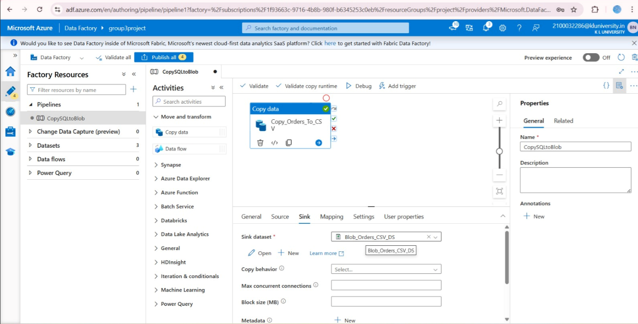

Slide 7
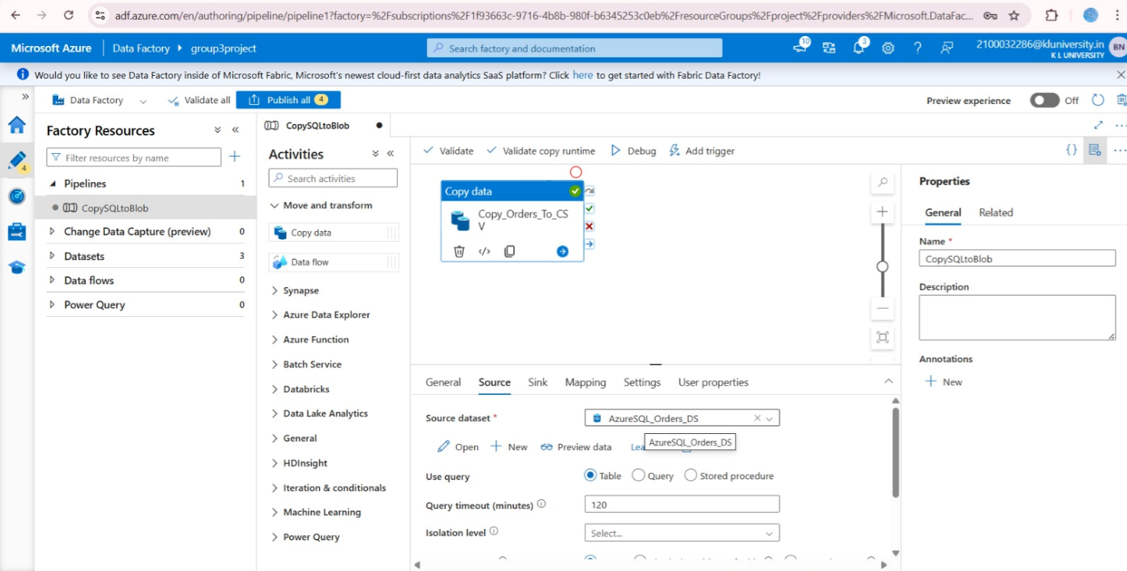

Slide 8
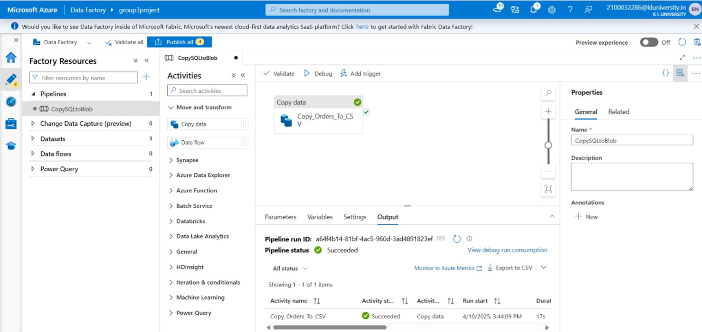

Slide 9
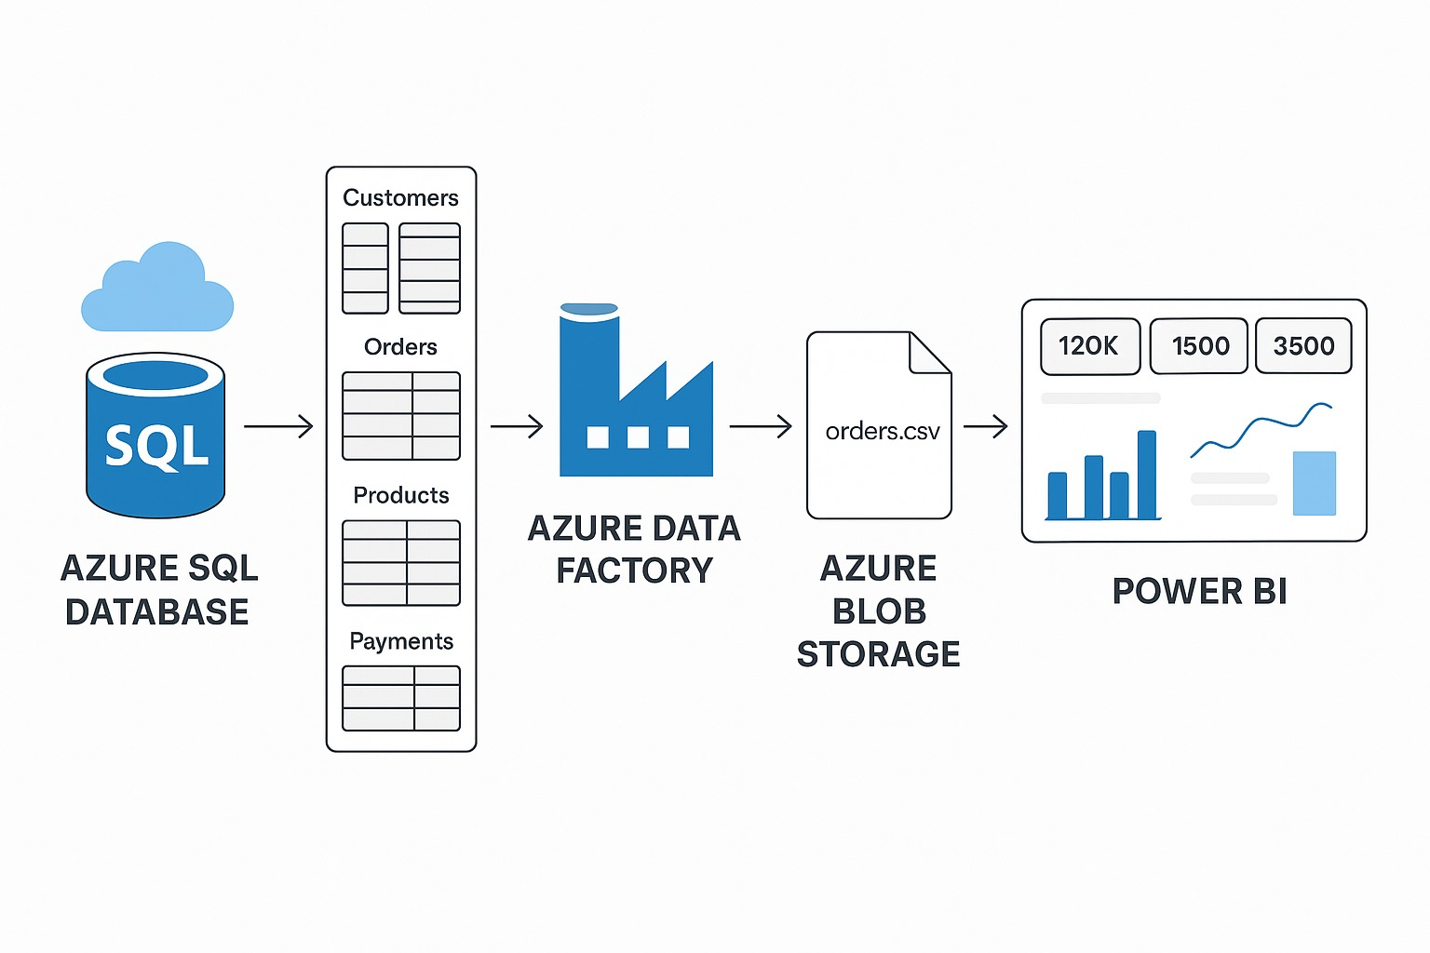
Pipeline

Slide 10

Power BI Dashboard
Visualizations Included:
- KPI Cards: Total Revenue, Orders, Quantity
- Bar Chart: Product-wise sales
- Date Slicer for trend filtering
- Table for detailed records

Slide 11
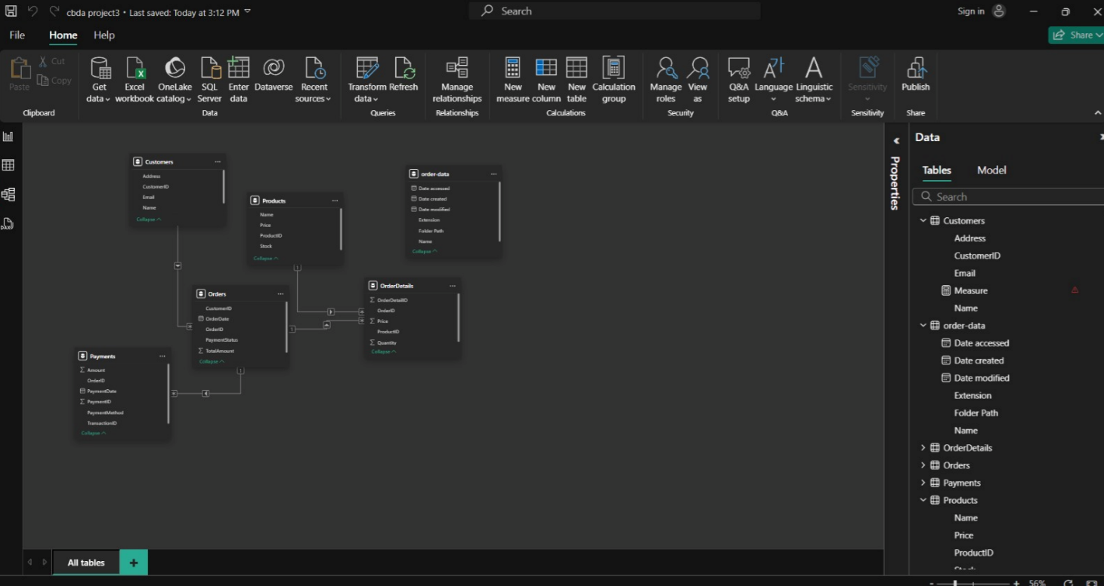
Power BI Representation

Slide 12
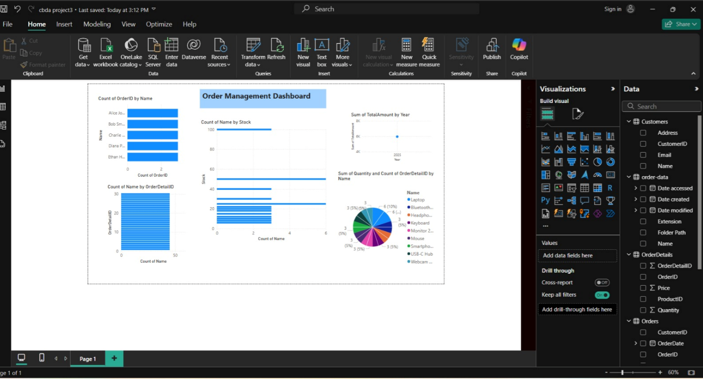

Slide 13
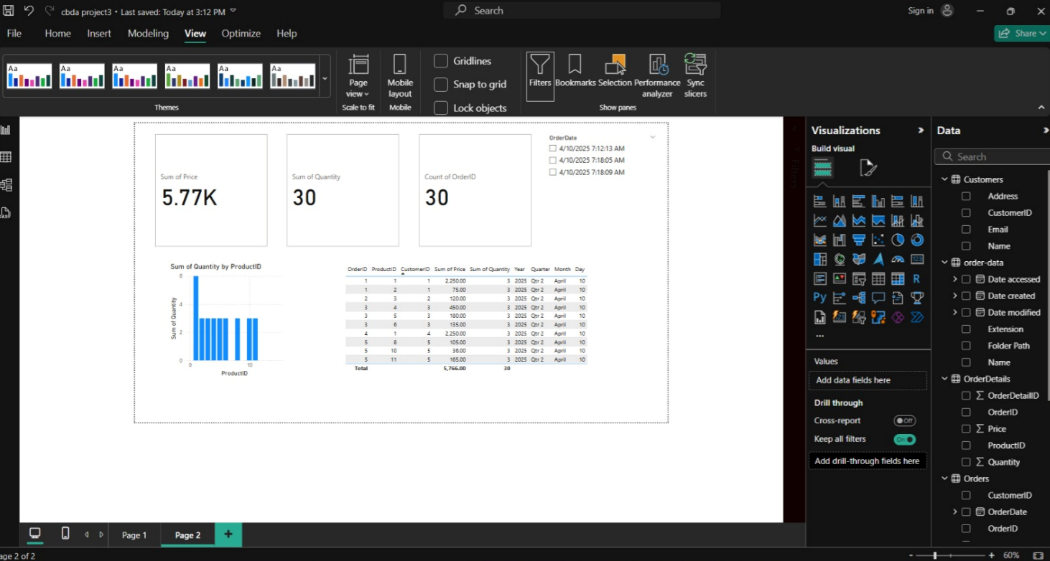

Slide 14
Architecture Diagram
Explanation:
This diagram illustrates the data flow from Azure SQL to Blob Storage and then into Power BI ADF.

Slide 15
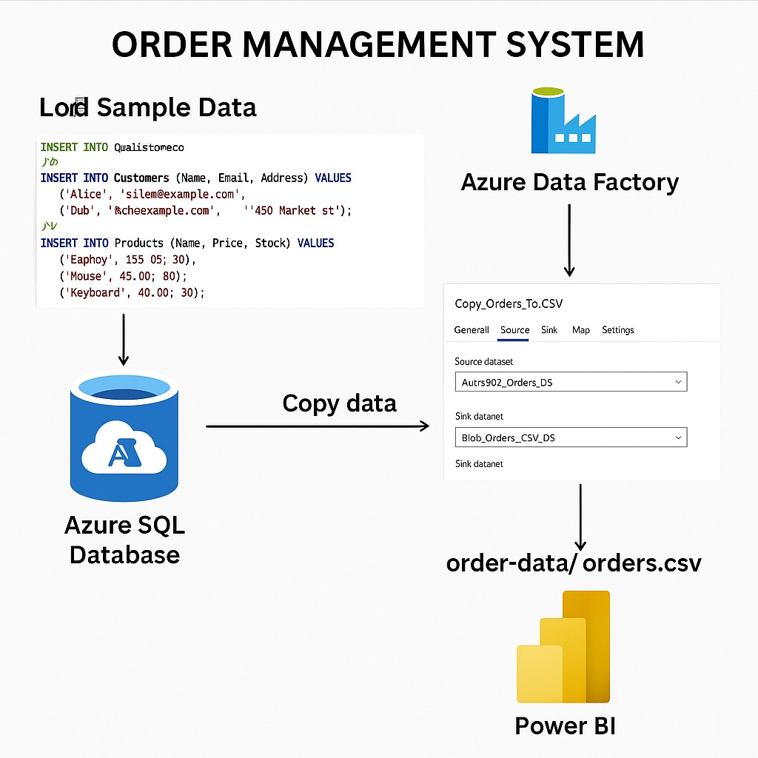
ARCHITECTURE

Slide 16
Learnings & Takeaways
✅ Built a complete cloud-based data pipeline
✅ Understood how to connect services in Azure
✅ Gained experience with ETL and data visualization
✅ Learned to communicate insights effectively through dashboards

Slide 17


